Slide 1
FINAL PROJECT PRESENTATION
UNC CHARLOTTE · ECE
Image Captioning with a CNN Encoder and Attention-Based Decoders
A controlled comparison of five decoder architectures
Anthony Kang · Aadit Chetan
FLICKR8K / RESNET-50 / GRU / TRANSFORMER
Notes:
Good afternoon. I'm Anthony, this is Aadit. Our project is an image captioning system — a CNN encoder paired with five different language decoders. The word to hold onto in this title is 'controlled': the interesting part of our work isn't that we built a captioner, it's that we built one testbed strict enough to say something trustworthy about whether attention actually helps.

Slide 2
1 — INTRODUCTION AND MOTIVATION
Image captioning: perception and language in one model
A captioner must both find the salient content of an image and write it as grammatical text — a compact vehicle for joining a convolutional encoder to a sequence decoder.
Accessibility
Weak labeling
Automatically generated alt-text lets screen-reading software convey visual web content to users with visual impairments.
Machine-written descriptions can pre-annotate large image collections before human refinement in downstream vision tasks.
Notes:
Image captioning sits exactly at the intersection of the two halves of this course. The model has to perceive what's in the image, and then render that perception as fluent grammatical English. Two applications motivate us beyond the coursework. First, accessibility: automatically produced alt-text is how screen readers convey visual web content to users with visual impairments. Second, weak labeling: a model that maps images to descriptive text can pre-annotate large image collections before a human ever looks at them.

Slide 3
1 — INTRODUCTION AND MOTIVATION
Which decoder wins when the visual front end is held fixed?
A strong pretrained encoder may shrink the benefit of spatial attention that was decisive in early captioning work built on weaker features.
HYPOTHESIS
DESIGN
Rather than assume attention helps, we set up an experiment in which it is free to help, tie, or lose — and we report per-seed variation so that small differences are not over-interpreted.
Notes:
Here's the framing that makes this an experiment rather than a demo. Early captioning work — Show, Attend and Tell — showed attention was decisive, but it was built on much weaker visual features. A ResNet-50 pretrained on ImageNet already hands the decoder a rich representation before any language model sees it. So our hypothesis is that the incremental benefit of spatial attention may be more modest than the classic literature suggests, when the encoder is this capable and the dataset is this small. We deliberately built the setup so attention is free to help, tie, or lose — and we measure it under conditions strict enough to trust the answer either way.

Slide 4
2 — APPROACH
One frozen encoder, five interchangeable decoders
FROZEN · CACHED
THE VARIABLE
INPUT
OUTPUT
ResNet-50 encoder
Decoder ×5
Image 224×224
Caption tokens
49 × 2048 spatial features
one shared interface
Data, preprocessing, optimizer, decoding, and scoring are held identical. Every decoder trains on numerically the same cached feature tensors, so performance differences primarily reflect decoder architecture under the shared protocol .
Notes:
Every model shares the same encoder-decoder structure. An image goes once through a frozen convolutional encoder to produce spatial feature vectors; a decoder then generates the caption token by token conditioned on those features. The only component that changes across our five experiments is the decoder. Because the encoder is frozen and its outputs are cached to disk, every decoder trains on numerically identical image features — that's what lets us attribute any difference to architecture.

Slide 5
2 — APPROACH
Encoder: a frozen ResNet-50, cached once
ResNet-50 pretrained on ImageNet (torchvision IMAGENET1K_V2 weights), with the global-average-pool and classification layers removed.
FEATURE MAP
7 × 7
Parameters receive no gradient. Each image is encoded exactly once and its features written to disk — a computational choice and an experimental guarantee at the same time.
spatial locations
Correction to the proposal. We stated a 14×14 grid; at 224×224 input, ResNet-50's final stage yields 7×7. All results use the correct features.
2048
channels per location
Notes:
The encoder is a ResNet-50 pretrained on ImageNet, torchvision's IMAGENET1K_V2 weights. We strip the global-average-pool and classification layers and keep the last convolutional feature map. One correction worth flagging: our proposal said a 14 by 14 grid. At the 224 by 224 input resolution we actually use, ResNet-50's final stage produces a 7 by 7 grid — 49 locations. The implementation and every number we report use the correct 7 by 7 features; the proposal figure was an error. Freezing is both computational — each image is encoded exactly once and cached — and experimental, since it guarantees identical inputs to every decoder.

Slide 6
2 — APPROACH
Five decoders, from a hard bottleneck to full self-attention
GRU models: embedding 256, hidden 512, dropout 0.3. Transformer: d_model 512, FFN 1024. Shared: data, decoding, scoring, and LR-search budget.
01
GRU, no attention
Mean-pool 49 vectors → tanh projection → GRU initial hidden state. Never attends back to the image: the reference point.
02
GRU + Luong
Dot-product score between the GRU hidden state and each projected location; the context vector is concatenated into the output projection. 5.23M params.
03
GRU + Bahdanau
Additive scoring through an alignment MLP over hidden state and projected features, one head. 5.76M params.
04
GRU + multi-head
Scaled dot-product attention over the 49 locations with 4 heads, concatenated and projected. 6.29M params.
05
Transformer decoder
2 layers, 4 heads, d_model 512, FFN 1024, learned positional embeddings, cross-attention over the 49 features. 10.03M params.
Notes:
Here are the five decoders. The baseline mean-pools the 49 spatial vectors into one image vector, projects it through a learned linear layer with tanh to initialize a single-layer GRU, and then generates autoregressively — crucially, after initialization it never attends back to the image. All visual information has to squeeze through that fixed-size initial hidden state. That bottleneck is exactly what attention was invented to remove, which makes the no-attention GRU the natural reference point. The GRU variants use 256-dimensional embeddings and 512-dimensional hidden states; the Transformer uses d_model 512 and feed-forward dimension 1024.

Slide 7
2 — APPROACH
What makes the comparison mechanically fair
SHARED DECODER INTERFACE
DATA-INTEGRITY SAFEGUARDS
One interface, so the harness is identical for all five
SHA-256 hashes gate every run
Splits, tokenized captions, vocabulary, and canonical image ordering are hashed once. A feature cache built from a different image order has the same tensor shape and would silently mispair every image — the hash rejects it instead.
A teacher-forced forward pass returns per-token logits, plus an incremental single-step decode used identically at evaluation. Recurrent attention models expose per-step spatial weights shaped [batch, heads, 49]; native Transformer cross-attention maps are not visualized.
We train on separate machines and merge results, so the hashes guarantee all five models were trained against one and the same data definition. Final evaluation refuses to run unless they match.
Notes:
Two pieces of machinery make the comparison mechanically fair rather than just nominally fair. First, a shared decoder interface: every decoder implements the same teacher-forced forward pass and the same incremental single-step decode. Because the harness calls one interface, the training loop, decoding, scoring, and logging code are identical for all five models. The recurrent attention models expose per-step spatial weights for visualization; our Transformer implementation does not expose native cross-attention matrices, so we do not show Transformer heatmaps. Second, data-integrity safeguards. The data definition is content-hashed with SHA-256, and the cached features are bound to a hash of the image ordering. A feature cache built from a different image order would have the identical tensor shape and would silently mispair every image with another image's features — the hash catches it. We train on separate machines and merge results, so this is not hypothetical.

Slide 8
3 — DATASET AND TRAINING SETUP
Flickr8k under the standard Karpathy splits
8,091
30,000
2,541
6/1/1k
images, 5 captions each
training image–caption pairs
vocabulary tokens (min count 5)
train / val / test images
Captions are lowercased and tokenized. The vocabulary is built from training captions only , with special <start>, <end>, <pad>, and <unk> symbols.
We adopt the Karpathy splits so the setup is structurally comparable to published baselines — though we do not treat our absolute scores as directly comparable.
Notes:
Flickr8k: 8,091 images, five human-written captions each. We use the Karpathy splits — 6,000 train, 1,000 validation, 1,000 test — because they're widely used and make our setup comparable to published work in structure, if not in absolute numbers. Captions are lowercase and tokenized; the vocabulary is built from training captions only, keeping words that appear at least five times, giving 2,541 tokens including start, end, pad, and unk. Since we pair each image with each of its five captions, training is 30,000 image-caption pairs.

Slide 9
3 — DATASET AND TRAINING SETUP
Shared training protocol across all five models
OPTIMIZATION
SHARED BEFORE IMPLEMENTATION
Optimizer
Adam
GRU models
• embedding 256
• hidden state 512
Transformer
• d_model 512
• FFN 1024
Shared across all models
• batch 64, dropout 0.3
• max 30 epochs, patience 6
• same data, metrics, and LR-search budget
Loss
Cross-entropy, padding masked
Gradient clip
5.0
Batch size
64
Early stopping
30 epochs max, patience 6
Hardware
1× NVIDIA T4, Colab
Notes:
Training is deliberately boring and shared wherever it should be shared. Adam, cross-entropy with teacher forcing, gradient-norm clipping at 5.0, batch size 64, up to 30 epochs with early stopping on validation BLEU-4 with patience 6. Padding tokens are masked out of the loss. The GRU models use embedding size 256 and hidden size 512, while the Transformer uses model dimension 512 and feed-forward dimension 1024. Dropout, the data pipeline, evaluation code, and the same three-value learning-rate search budget were fixed before model implementation. Everything ran on a single T4 in Colab.

Slide 10
3 — DATASET AND TRAINING SETUP
A protocol designed to make the comparison defensible
01
02
03
Per-architecture LR search
Three fresh seeds
Validation-only selection
Each model trained once at 1e-4, 3e-4, and 1e-3 on a single dedicated search seed; best rate chosen on validation BLEU-4.
Retrained at the selected rate under three new seeds — the search run is never reused, since its score was optimistically selected. Same seeds for every model enables paired comparison.
Rates and checkpoints chosen solely on validation BLEU-4. Final test evaluation is run once after all decisions are frozen into a manifest
Disclosure. Preliminary test scores were computed for the baseline during early pipeline development, before this protocol was finalized. No test evaluation occurred afterward until all decisions were frozen. We report final test numbers with that caveat.
Notes:
This is the slide I'd point to if you asked what's actually novel about our setup. Three steps. One: a per-architecture learning-rate search over 1e-4, 3e-4, 1e-3 using one dedicated search seed — a shared rate wouldn't be equally fair to architectures with different optimization behavior. Two: three independent fresh seeds at the selected rate. We do not reuse the search run as one of the three, because its score was optimistically selected. And because the same three seeds are used for every model, we can compare pairwise seed-by-seed. Three: model selection only on validation BLEU-4; the test set is evaluated once, after every decision is frozen into a manifest. One honest disclosure at the bottom: during early pipeline development, before this protocol existed, we did compute preliminary test scores for the baseline. After the protocol was adopted we stopped. So the test set was not entirely unseen for the baseline, and we report final numbers with that caveat.

Slide 11
4 — EVALUATION, RESULTS, AND ANALYSIS
Baseline: mean validation BLEU-4 of 0.1873
No-attention GRU · 4,185,837 trainable parameters · selected learning rate 3×10⁻⁴
SEED
SEL. EPOCH
BLEU-1
BLEU-2
BLEU-4
VALIDATION SEED VARIATION
1
8
0.6070
0.4226
0.1874
0.0002
2
13
0.6016
0.4196
0.1874
Three-seed standard deviation in validation BLEU-4. An improvement smaller than roughly this spread cannot be distinguished from seed variation.
3
13
0.6089
0.4227
0.1870
Mean
—
0.6058
0.4216
0.1873
Std. dev.
—
0.0038
0.0018
0.0002
The floor is model-specific: the attention decoders ran 0.0009–0.0035, so we judge each comparison against the noisier of the two models.
Notes:
Here's the baseline across its three final seeds at the selected rate of 3e-4. Look at the standard deviation on BLEU-4: 0.0002. Validation BLEU-4 varies by only four ten-thousandths across seeds. That tightness is itself a useful result, because it establishes the noise floor. Any improvement from an attention model that's smaller than roughly this spread cannot be distinguished from seed variation — and without having measured it, we'd have been tempted to read any difference as real.

Slide 12
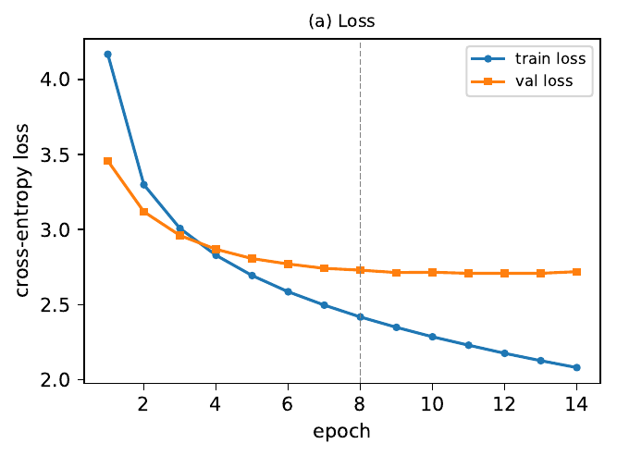
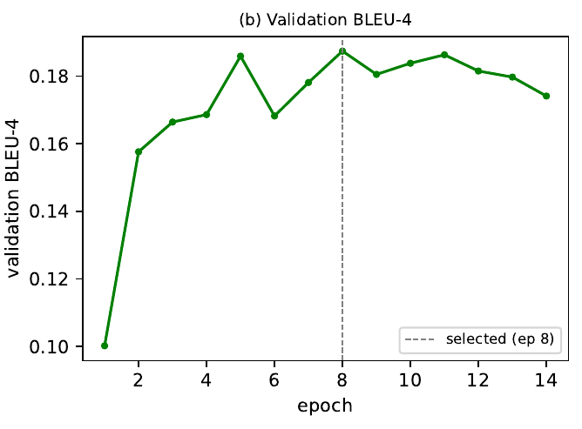
4 — EVALUATION, RESULTS, AND ANALYSIS
Validation loss and validation BLEU-4 peak at different epochs
Baseline, seed 1. Loss reaches a broad minimum around epochs 9–13; BLEU-4 peaks at epoch 8.
FIGURE 1(A)
FIGURE 1(B)
Training vs. validation cross-entropy loss (seed 1)
Validation BLEU-4 with selected-epoch marker (epoch 8)
Checkpointing on loss would have shipped a different — and by the metric we report, worse — model. This is why selection is on BLEU-4.
Notes:
Training dynamics for one representative seed. Training loss falls monotonically; validation loss flattens and then ticks up slightly after about epoch 11 — the familiar sign of mild overfitting. But validation BLEU-4 doesn't track validation loss. It sits on a noisy narrow plateau from about epoch 5 onward, and the two criteria disagree about the best epoch: validation loss bottoms out around epoch 11, while validation BLEU-4 for this seed peaks at epoch 8. That divergence is exactly why we select checkpoints on BLEU-4 — the quantity we actually report — rather than on loss.

Slide 13
4 — EVALUATION, RESULTS, AND ANALYSIS
Attention is not a free win: gains depend on the mechanism
Validation BLEU-4, mean over three matched seeds. Δ columns are per-seed differences against the baseline at the same seed.
MODEL
PARAMS
LR
VAL BLEU-4
SEED STD
Δ VS BASELINE, PER SEED
GRU (no attention)
4.19M
3e-4
0.1873
±0.0002
—
GRU + Luong
5.23M
3e-4
0.1735
±0.0009
−0.0134 / −0.0133 / −0.0145
GRU + Bahdanau
5.76M
3e-4
0.1974
±0.0035
+0.0117 / +0.0060 / +0.0128
GRU + multi-head
6.29M
3e-4
0.1863
±0.0017
+0.0007 / −0.0028 / −0.0008
Transformer
10.03M
1e-4
0.1959
±0.0028
+0.0109 / +0.0090 / +0.0058
Bahdanau leads validation BLEU-4. Transformer also improves validation BLEU-4, but is larger, slower, and selected a lower LR. Baseline still leads on METEOR.
Luong is lower than baseline on all three seeds. Dot-product scoring against a frozen ResNet feature space appears to hurt here.
Multi-head: no consistent gain. Deltas straddle zero at 50% more parameters — not a clear improvement.
Notes:
This is the headline validation table, all five decoders, three matched seeds each. Bahdanau is the best decoder at 0.1974 mean validation BLEU-4, about ten points of a thousandth above the baseline, and the gain is positive on all three matched seeds. The Transformer also improves validation BLEU-4 on all three seeds, but it needed a lower learning rate — 1e-4 — and two and a half times the parameters. Now the surprises. Luong attention is lower than having no attention at all: about minus 0.013, negative on every seed. And multi-head attention shows no consistent advantage — the per-seed deltas straddle zero despite fifty percent more parameters. So attention is not a free win, and that is only a defensible claim because we ran matched seeds and know what the variation looks like.

Slide 14
4 — EVALUATION, RESULTS, AND ANALYSIS
Final test pass — and a metric that disagrees
Final test set, mean over three seeds, greedy decoding, run once against the frozen manifest.
MODEL
TEST BLEU-4
METEOR
TF-IDF OVERLAP
MS / IMAGE
GRU (no attention)
0.1987
0.4150
0.0403
0.43
GRU + Luong
0.1798
0.3850
0.0350
0.60
GRU + Bahdanau
0.2062
0.4115
0.0413
0.70
GRU + multi-head
0.1970
0.3985
0.0382
0.83
Transformer
0.1973
0.4033
0.0389
2.63
The winner depends on the metric. Bahdanau leads on BLEU-4 and TF-IDF overlap, but the no-attention baseline has the highest METEOR (0.4150 vs 0.4115). None of these gaps is large.
Latency is not like-for-like. The Transformer decodes by prefix-recompute; every GRU reuses recurrent state. Its 2.63 ms/image reflects decode policy, not attention cost. TF-IDF overlap is a simplified cosine, not CIDEr-D.
Notes:
This is the final test pass, run against the frozen manifest. The ordering from validation mostly holds: Bahdanau has the highest mean BLEU-4 at 0.2062, baseline is 0.1987, and Luong is lowest at 0.1798. But look at METEOR: the baseline is actually highest, 0.4150 against Bahdanau's 0.4115. So which model wins depends on which metric you ask, and none of these gaps is large. Two caveats we want to be explicit about. The TF-IDF overlap score is a simplified cosine inspired by CIDEr, not CIDEr-D, so we do not compare it to published CIDEr numbers. And on latency, the Transformer's 2.6 milliseconds per image is not a like-for-like architectural limit — it decodes by recomputing the whole prefix each step, while every GRU variant reuses recurrent state.

Slide 15
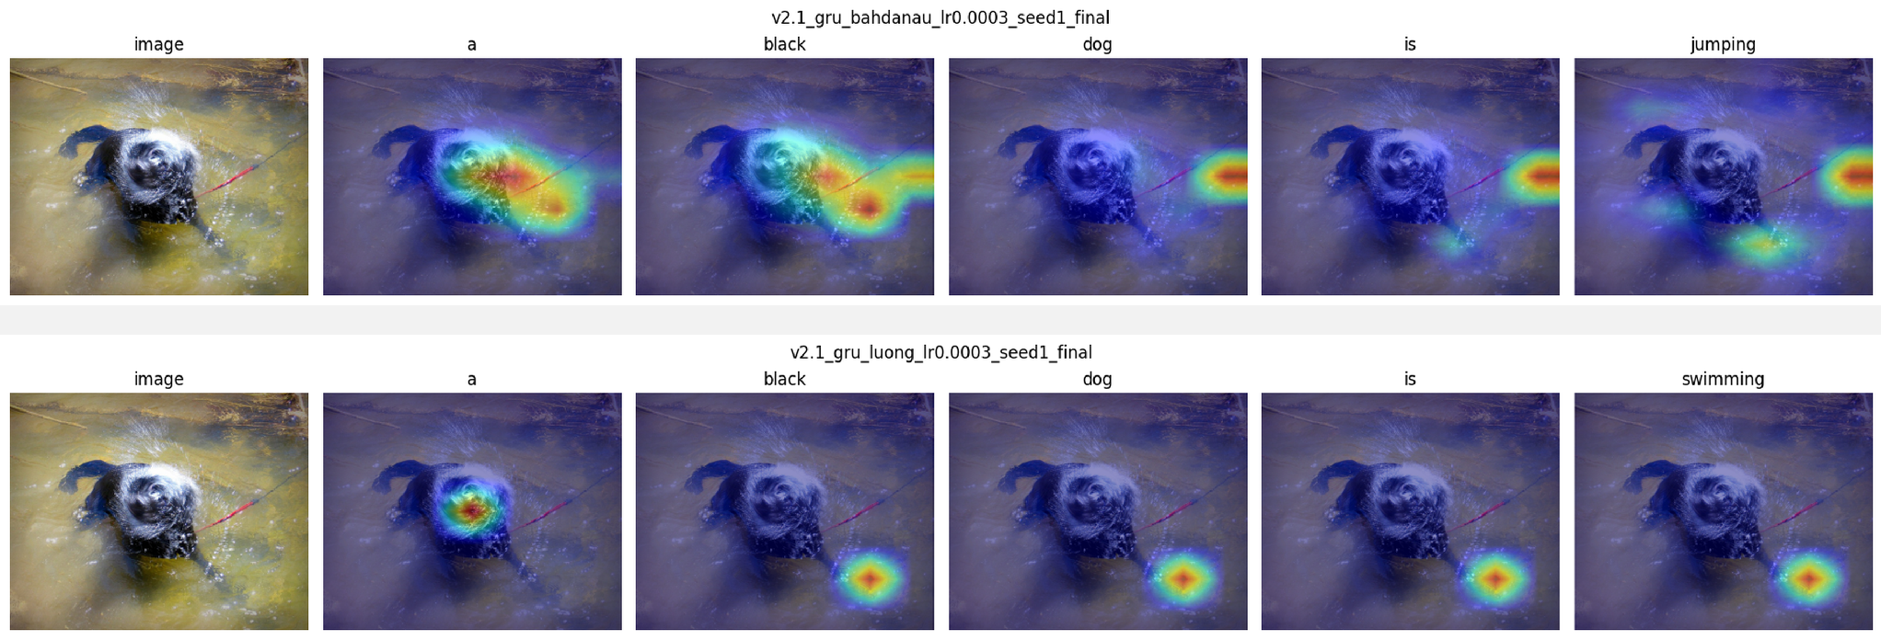
4 — EVALUATION, RESULTS, AND ANALYSIS
Qualitative analysis: where attention changes — and where it gets stuck
Per-word spatial attention on one validation image. Top: Bahdanau; bottom: Luong. This is an illustrative example, not proof of an architecture-wide cause.
Bahdanau varies across words and image regions. Luong, after the first word, repeatedly concentrates on nearly the same lower-right region. Each panel is min-max normalized per word for visibility.
Notes:
Beyond the numbers, the qualitative side. This slide compares the best BLEU-4 model and the lowest-scoring model on the same validation image. Bahdanau attention varies across generated words and spreads over the dog and surrounding water regions. Luong, after the first word, repeatedly returns to almost the same lower-right region. This is a single illustrative example, not proof of the architecture-wide cause, and each panel is independently min-max normalized for visibility. The point is that visualizations can suggest a plausible failure mode that the metrics alone would not show.

Slide 16
5 — LESSONS LEARNED
Most of our lessons were about discipline, not modeling
Measure the noise floor before ranking
The selection metric changes the answer
The baseline's three-seed BLEU-4 spread was 0.0002. Without that number we would have read any difference as real; with it, "model A scored higher" becomes a claim we can qualify.
Validation loss and validation BLEU-4 peaked at different epochs. Checkpointing on loss would have shipped a different — and by our reported metric, worse — model.
Reproducibility infrastructure earns its keep
A strong encoder did shrink the attention gap
Two machines, merged results: a misordered feature cache or a stale checkpoint were real risks. Content hashes and a frozen manifest caught them mechanically rather than by luck.
Our hypothesis held. Only Bahdanau achieved higher mean test BLEU-4 than the baseline, while the baseline still led on METEOR. The gain was ~0.010 BLEU-4 — not the decisive win the early literature reports on weaker features.
Notes:
Most of what we learned is about experimental discipline rather than modeling. First: measure seed-to-seed variation before ranking anything. Without that, we would have read any difference between models as real. Second: the selection metric matters. Loss and BLEU-4 peaked at different epochs, so checkpointing on loss would have reported a worse model by the metric we actually report. Third: reproducibility infrastructure earns its keep. We trained on separate machines and merged results — a differently ordered feature cache or a stale checkpoint were real risks, and content-hashing caught them mechanically instead of by luck. And the fourth is the payoff: the strong frozen encoder did shrink the attention gap the way we hypothesized. Only Bahdanau achieved a higher mean test BLEU-4 than the baseline, while the baseline still led on METEOR. The gain was about ten thousandths of BLEU-4 — not the decisive win early literature reports on weaker features.

Slide 17
5 — LESSONS LEARNED
What we would tell the next team
RECOMMENDATION
LIMITS OF THIS STUDY
Bahdanau for the strongest mean BLEU-4 and TF-IDF overlap, plus interpretable heatmaps.
Three seeds show the sign of an effect, not a strong statistical claim.
The plain GRU if cost matters: 4.19M parameters, 0.43 ms/image, highest METEOR of the five.
Flickr8k is small; the Transformer likely never got the data it wants. Beam search and a fine-tuned encoder remain untested.
Questions
ANTHONY KANG · AADIT CHETAN · UNC CHARLOTTE ECE
Notes:
To close. Bahdanau attention is the strongest decoder by mean BLEU-4 and TF-IDF overlap, but the honest headline is that the margin is small and not every attention mechanism earned its keep — Luong was lower than no attention on all three matched seeds, multi-head was a wash, and METEOR actually prefers the plain baseline. If you want a recommendation for this dataset and this encoder: Bahdanau if you want the strongest captioning scores and interpretable heatmaps; the plain GRU if you want the cheapest model that is nearly as good. Two limits we would fix with more time: three seeds are not enough for a strong statistical claim, and Flickr8k is small enough that the Transformer likely never got the data it wants. Thank you — happy to take questions.

